Slide 1

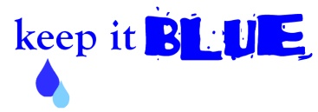
Water: An Important Resource
With a Focus on Wetlands
Marcy Colclough
Southwest Michigan
Planning Commission

Slide 2
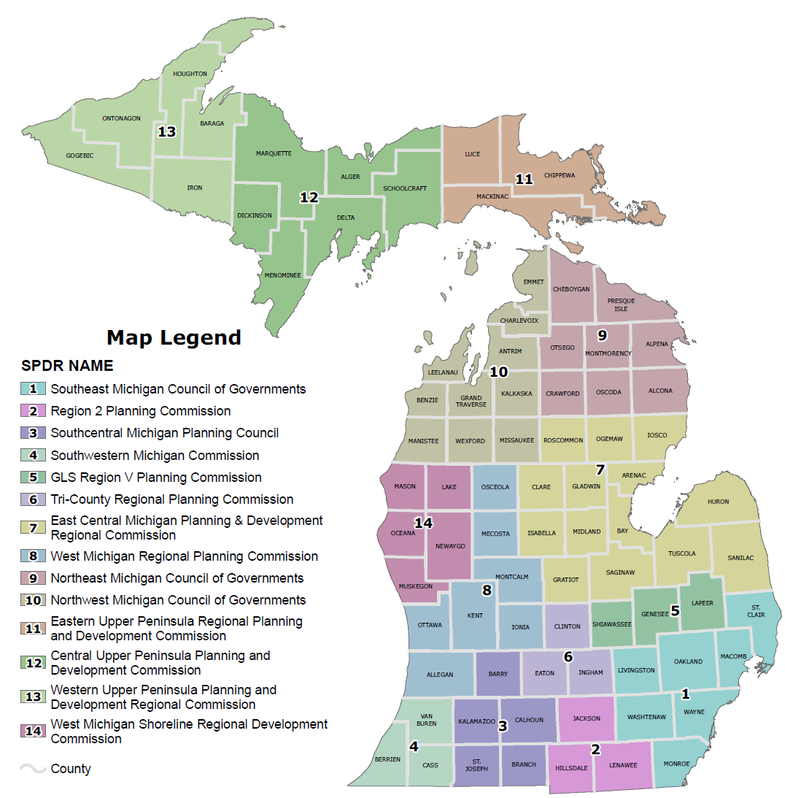
SWMPC
Regional Planning Agency for
Berrien, Cass and Van Buren
Counties
Address issues that cross
jurisdictional boundaries
  Economic development
  Community development
  transportation planning
  water quality and natural resources
Bring together local, state and
federal agencies and resources
for planning and funding
projects

Slide 3
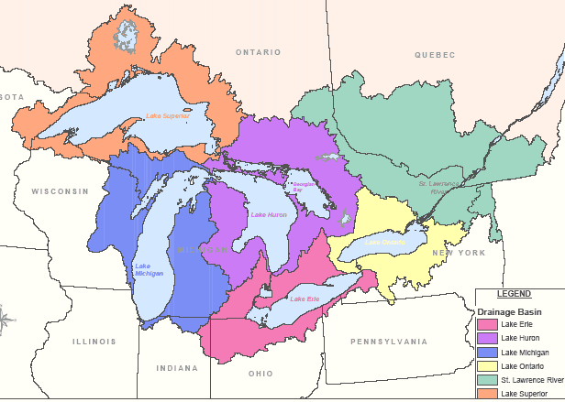
The Great Lakes
1/5 of the world’s fresh water supply
90% of the US fresh water supply
Drinking water for 42 million people
Spread evenly across the 48 states, the water would be about 9.5 feet deep.

Slide 4
Watersheds in Southwest Michigan

Slide 5
Water Resources
Berrien County
3,078 acres of inland lakes
500 miles of streams and rivers
42 miles of Lake Michigan shoreline

Slide 6
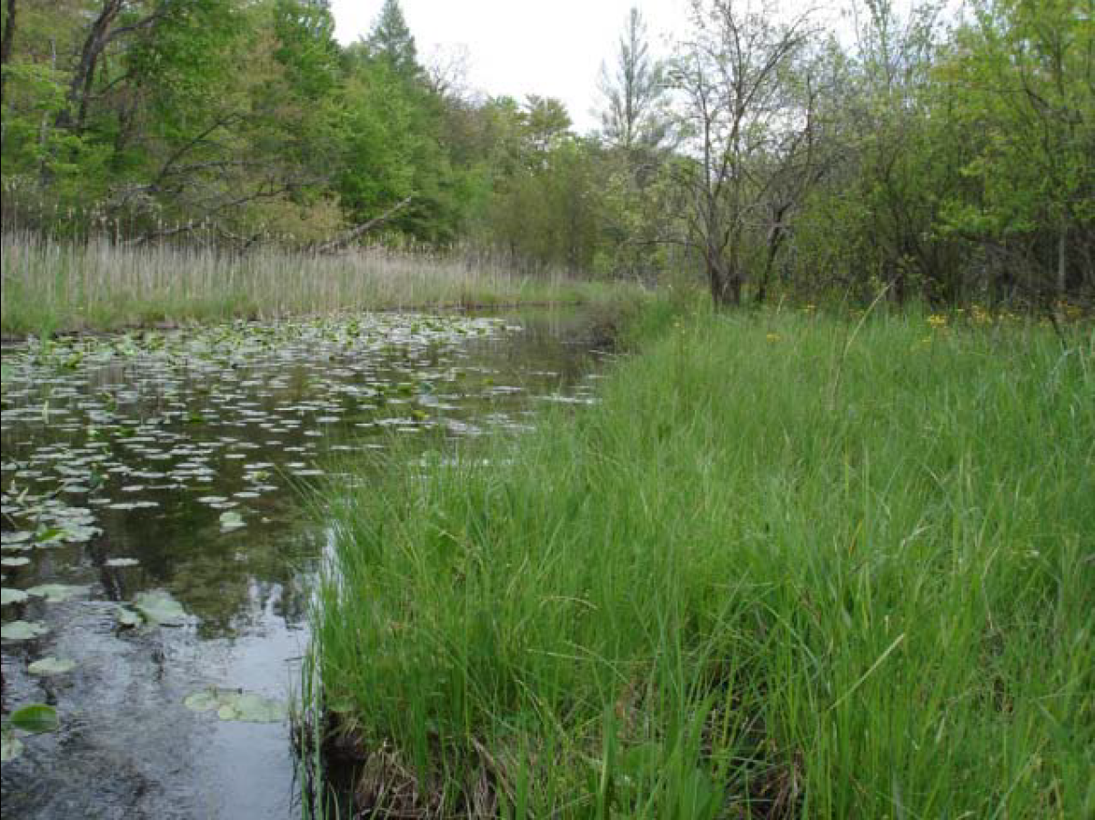
Wetlands…
Reduce soil erosion on lake and stream banks
Filter water (sediment, nutrients, etc)
Absorb water (reduce flooding)
Recharge groundwater (provide drinking water)
Provide habitat (fish, birds, amphibians, etc)
Provide recreation opportunities (hunting, fishing, bird watching, etc)

Slide 7
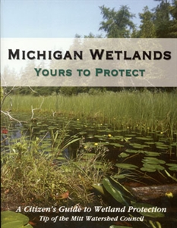
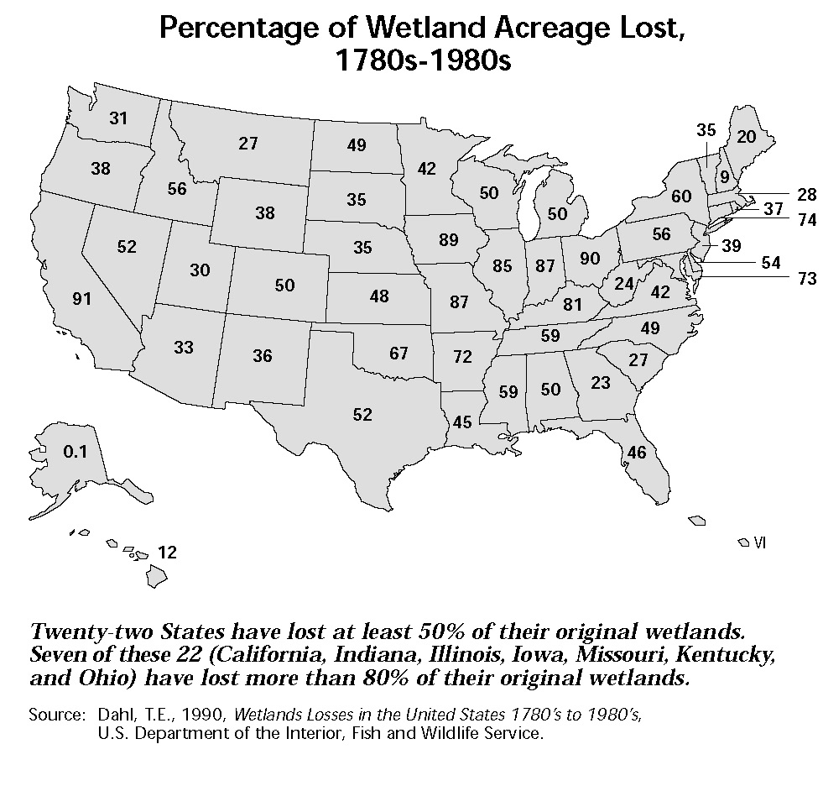
Wetland Loss
22 States – lost at least 50%
7 of 22 – lost more than 80%

Slide 8
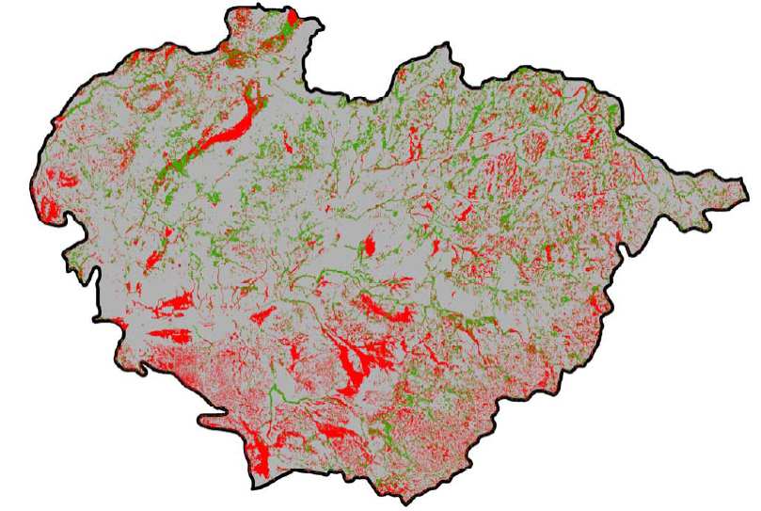
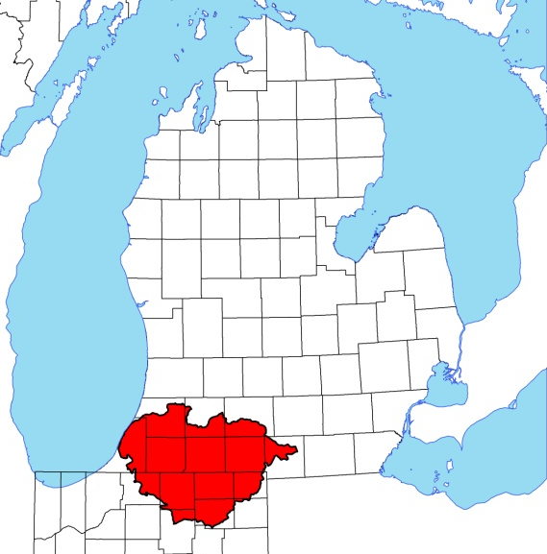
53% Wetland Loss
356,689 acres converted
Wetland Lost
Wetland Existing

Slide 9
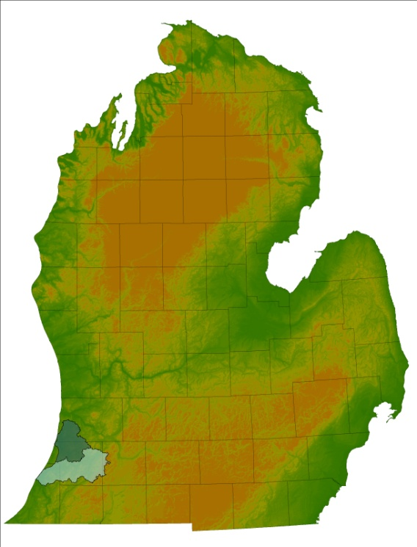
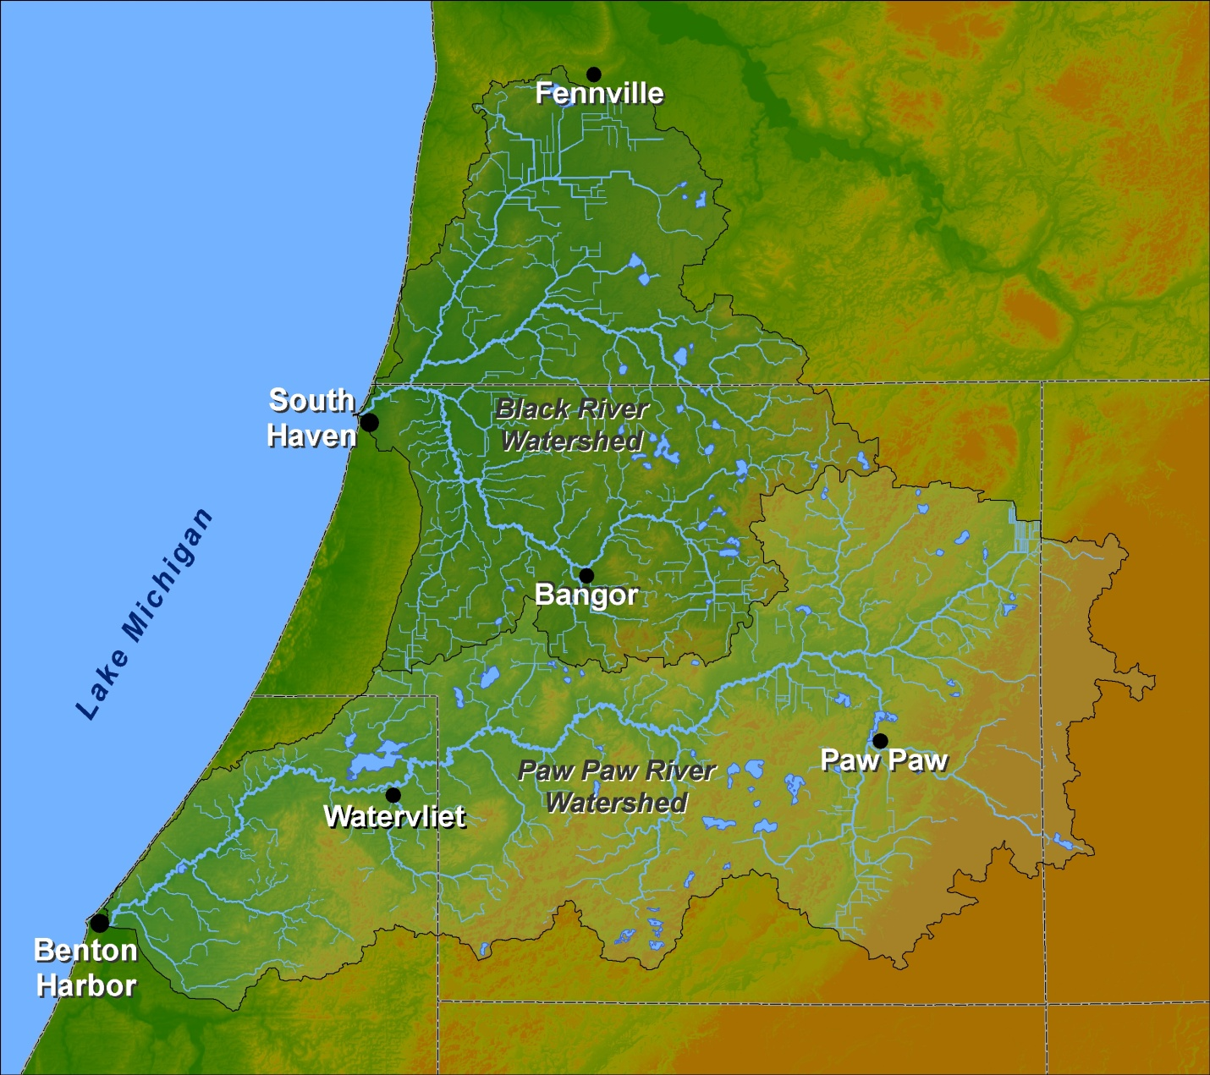
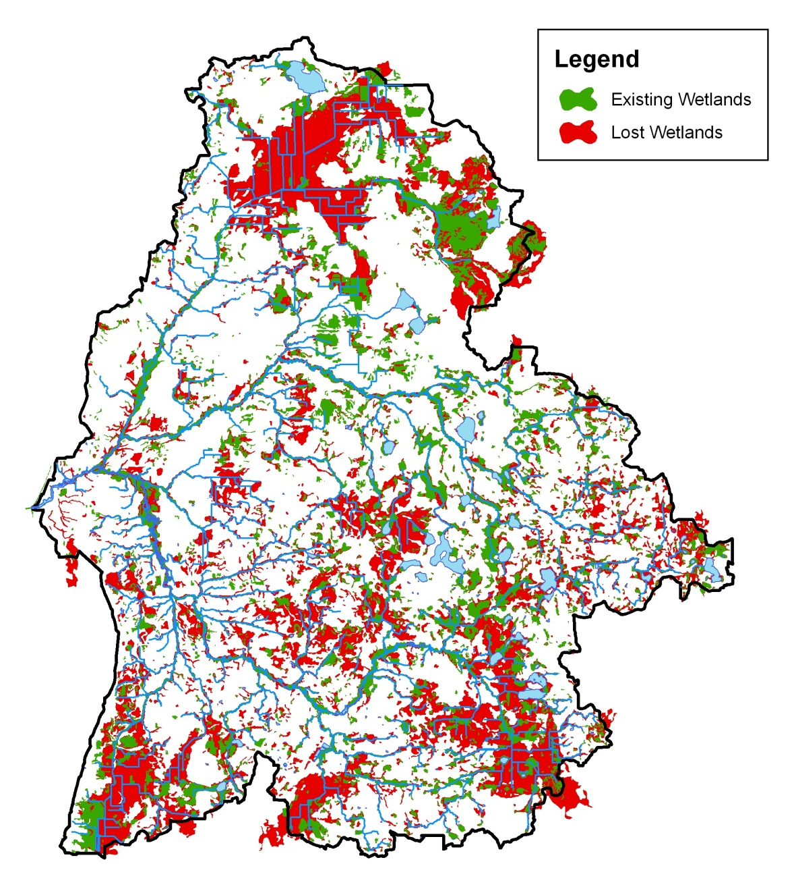
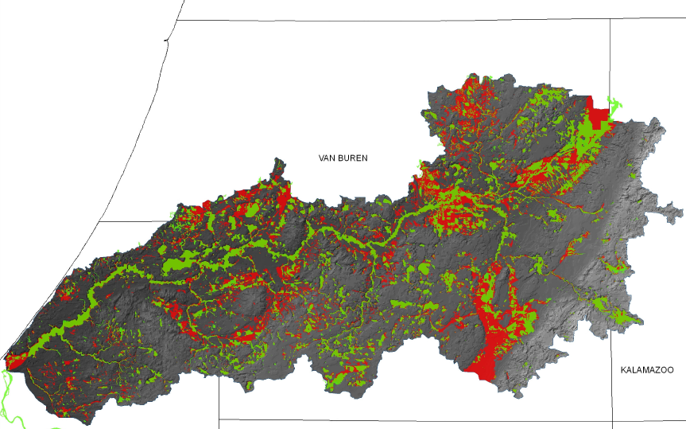
Paw Paw and Black River Watersheds
55% Wetland Loss
43% Wetland Loss
Notes:
Talk about 319 project; include inset locator map

Slide 10
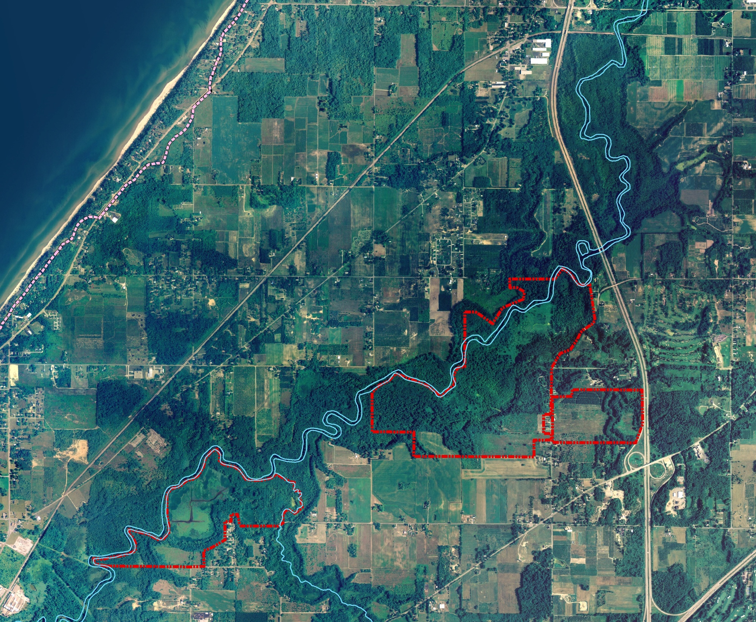
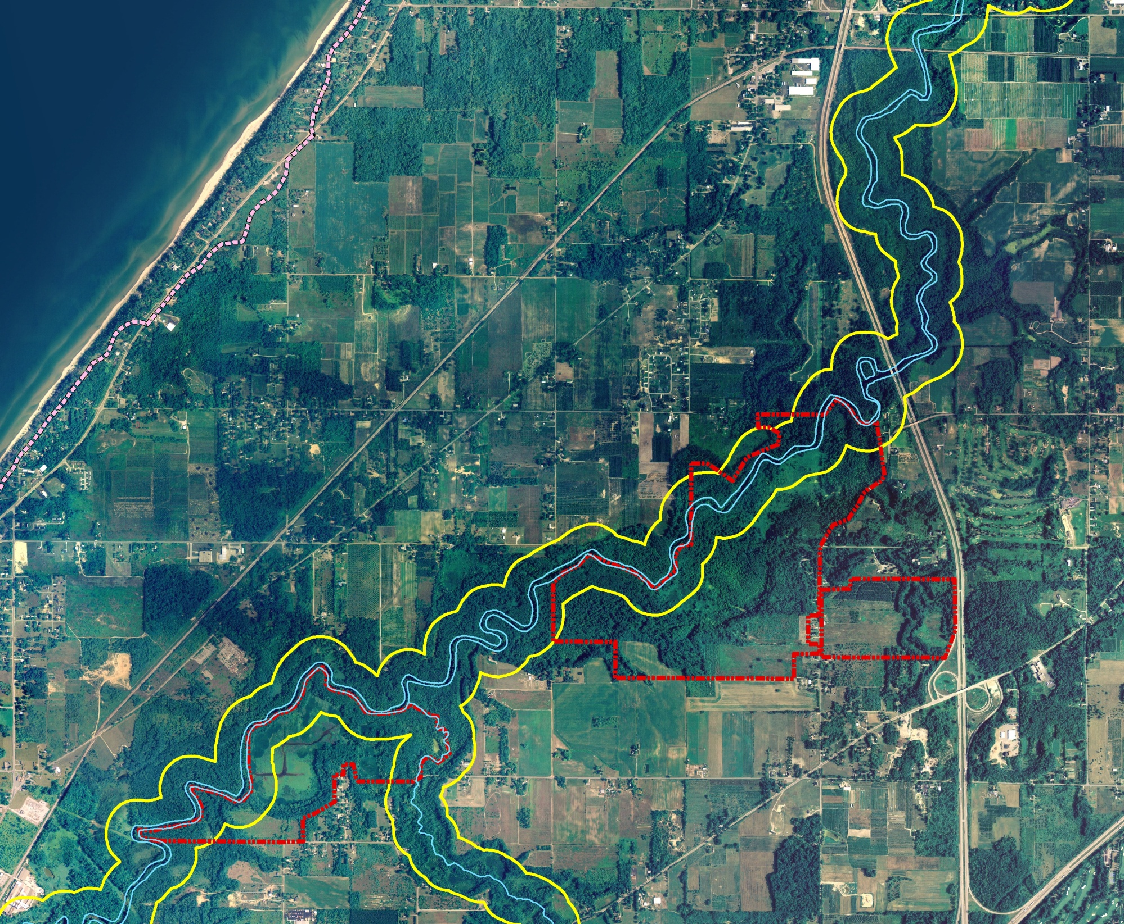

Slide 11
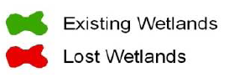
Wetland Protection and Restoration
Wetlands are Extremely
Important for Water Quality
Were do we start – We can’t
protect and restore all of them!
  limited resources
  not practical – we need food!
With 3,343 potential restoration
sites, we need to be strategic
Limited Resources
Appeal to Different Interests
Optimize Outcomes/
Spend Resources Wisely
Existing - 29,434 acres (45%)
Lost - 35,781 acres (55%)

Slide 12
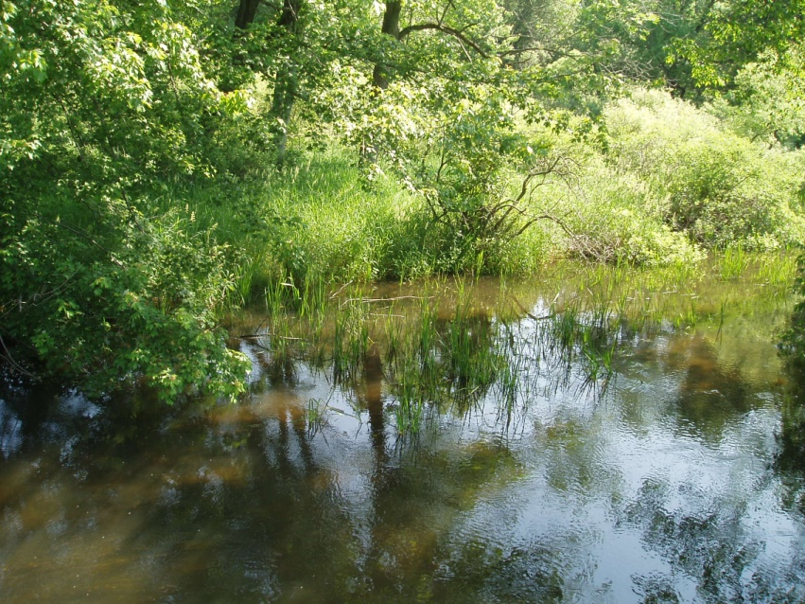
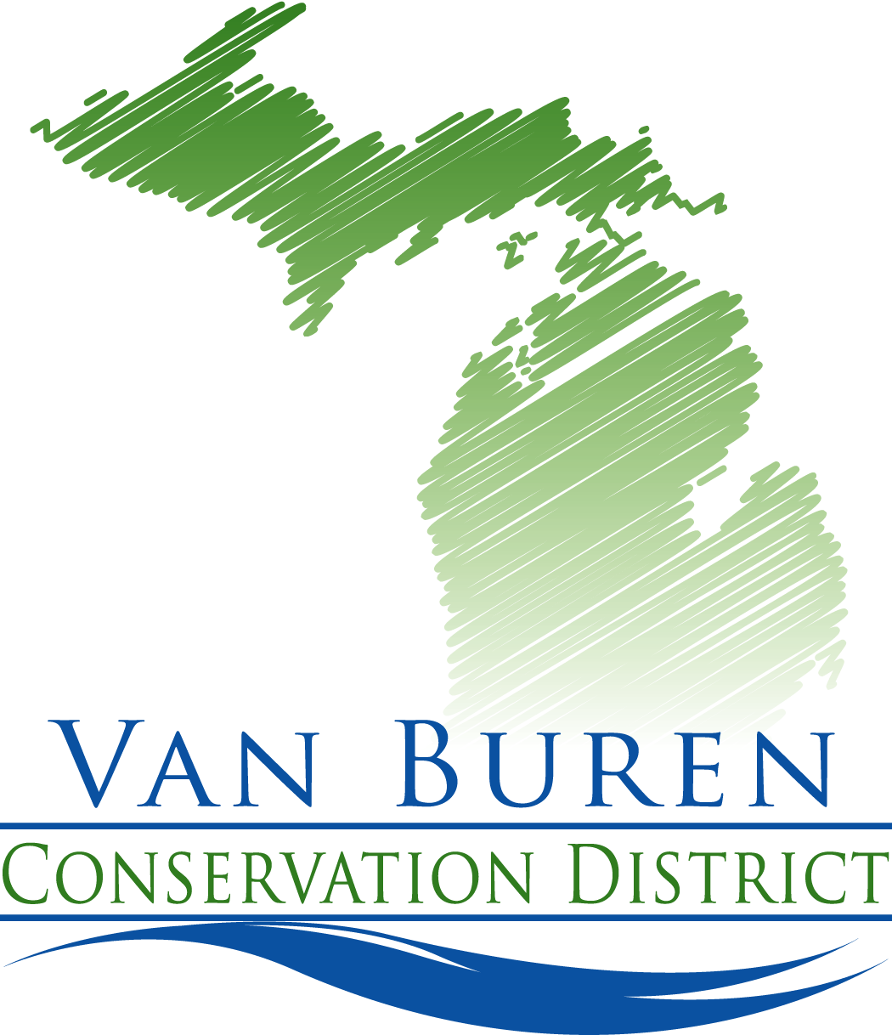
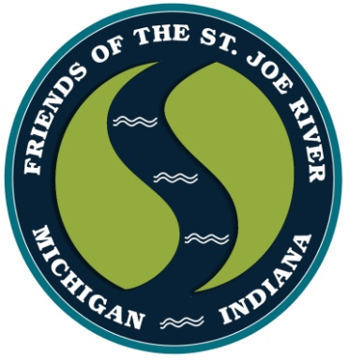
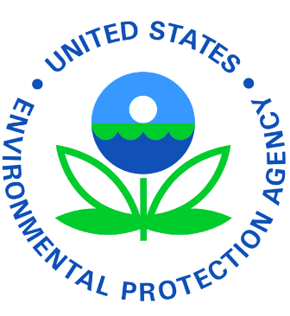

Prioritizing Wetlands for Water Quality
A strategy for watershed improvement
Assess wetland functions
Use results to direct implementation efforts
Notes:
Today we’ll just focus on restoration, but the same process, with slightly different criteria, can be used to prioritize sites for protection. Prioritize potential restoration or protection sites using criteria such as size, ownership and proximity to impaired waterbodies. Use prioritization results to direct implementation efforts (outreach campaigns, conservation planning, grant program dollar allocation and assistance with local municipal planning & zoning)

Slide 13
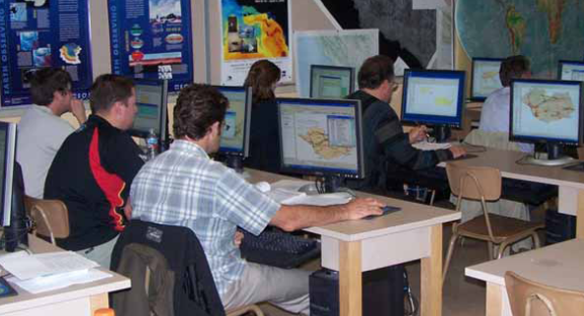
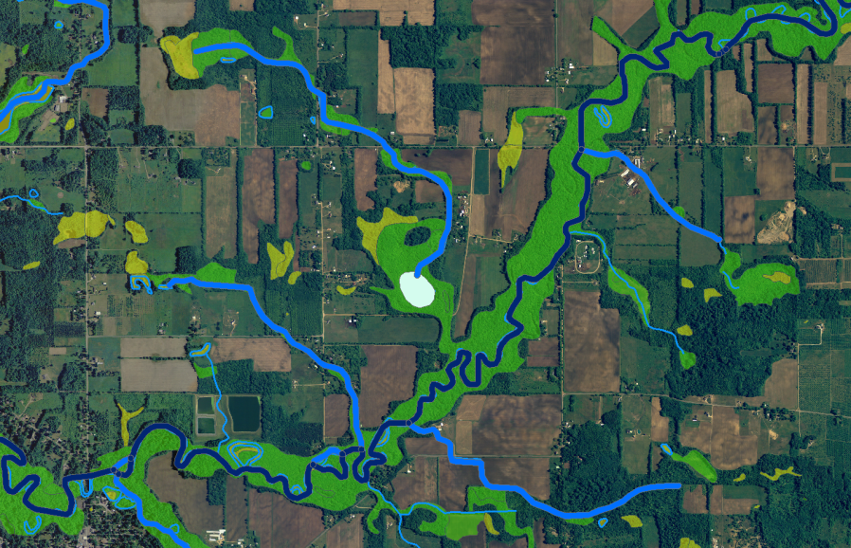
Assess Wetland Functions
Water Quality Functions
  Flood water storage – Reduce Flooding
  Streamflow maintenance – Stable Flows
  Nutrient transformation – Less Vegetation
  Sediment retention – Cleaner Water
  Shoreline stabilization – Less Erosion
  Groundwater recharge – Drinking Water
Habitat Functions
  Fish and Wildlife Habitat – Fishing, Hunting

Slide 14
Wetland Loss
What does 43-55% loss really mean?
Need to be Strategic – Restoration and Protection
  Limited Resources
  Appeal to Different Interests/Stakeholders
  Optimize Outcomes/Spend Resources Wisely
55% Acreage Lost
61% Flood Storage Capacity Lost
3,343 potential restoration sites (Black River)
626 potential restoration sites –
identified as significant for all 6 “water quality” functions

Slide 15
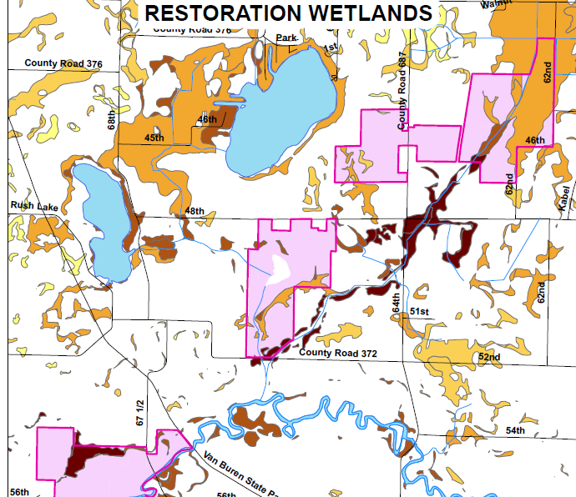
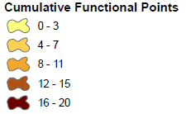
Water Quality Functions
Wetlands performing the 6 water quality functions at a high or medium significance.
3,343 potential sites
626 sites
307 sites (3 acres or greater)

Slide 16
Practicality
Wetlands that:
  Are within one parcel OR at least 95% of the wetland is within one parcel
  Have 100% of natural and/or agricultural land use within the site (no urban present)
  Landowner willingness!
100 acre wetland
3,343 potential sites
1,095 sites
508 sites (3 acres or greater)

Slide 17
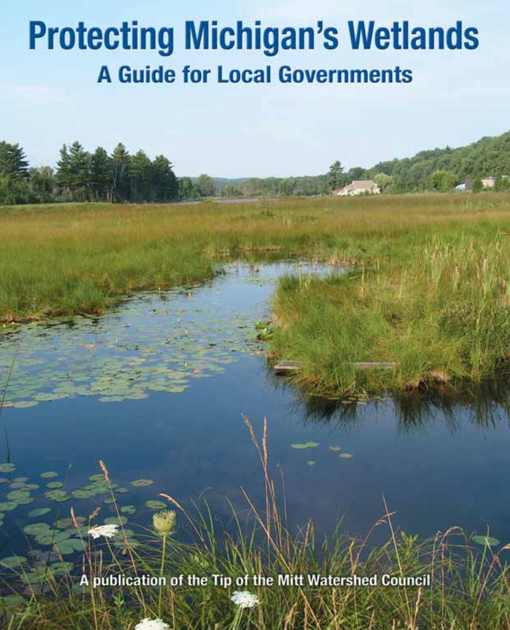
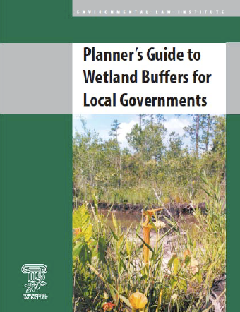
Next Steps
Who can use this data?
  Watershed Planning and Implementation Projects
  Drain Commissioners
  Municipalities
  Conservation Groups
  State Agencies
  Citizens/Citizen Groups
  Developers (mitigation)

Slide 18
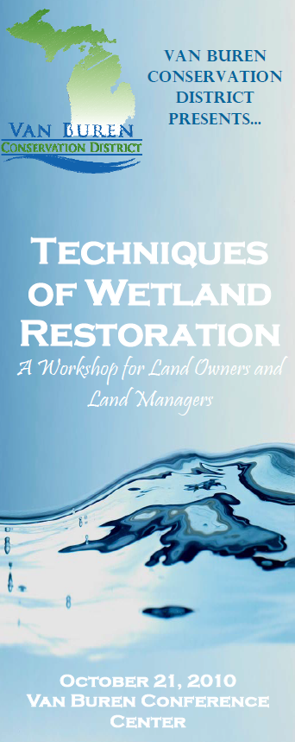

Watershed Projects
Use data to support proposals for grant funding to protect/
restore wetlands
Target outreach efforts
  Produce mailing lists

Slide 19
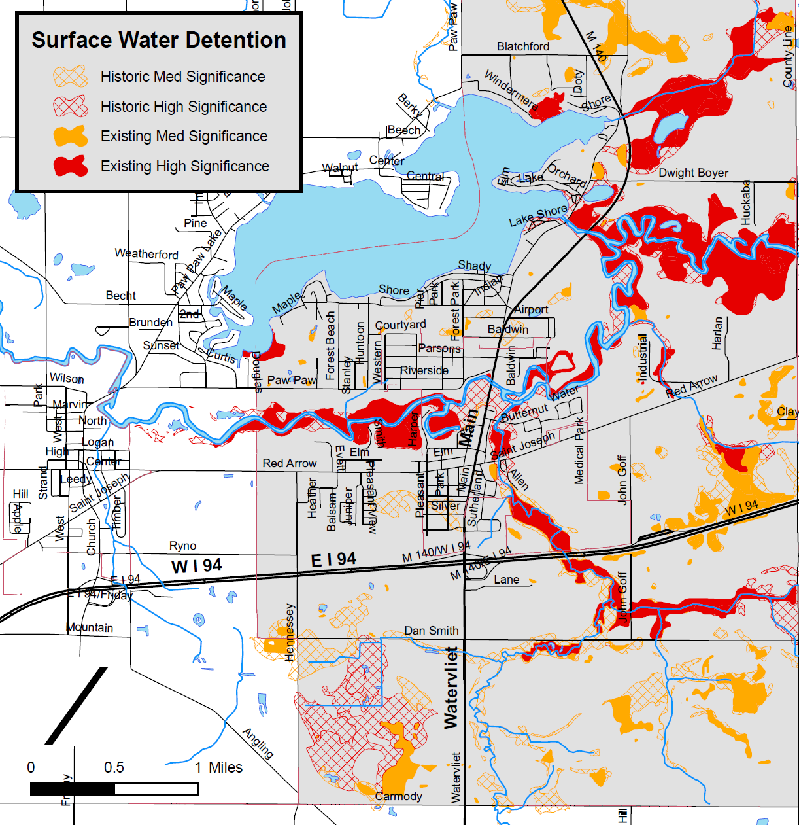
Drain Commissioners
Utilize Flood Water Storage function to take advantage of restoration/protection opportunities
  Purchase flood easements
  Restore wetland areas in drainage easements

Slide 20
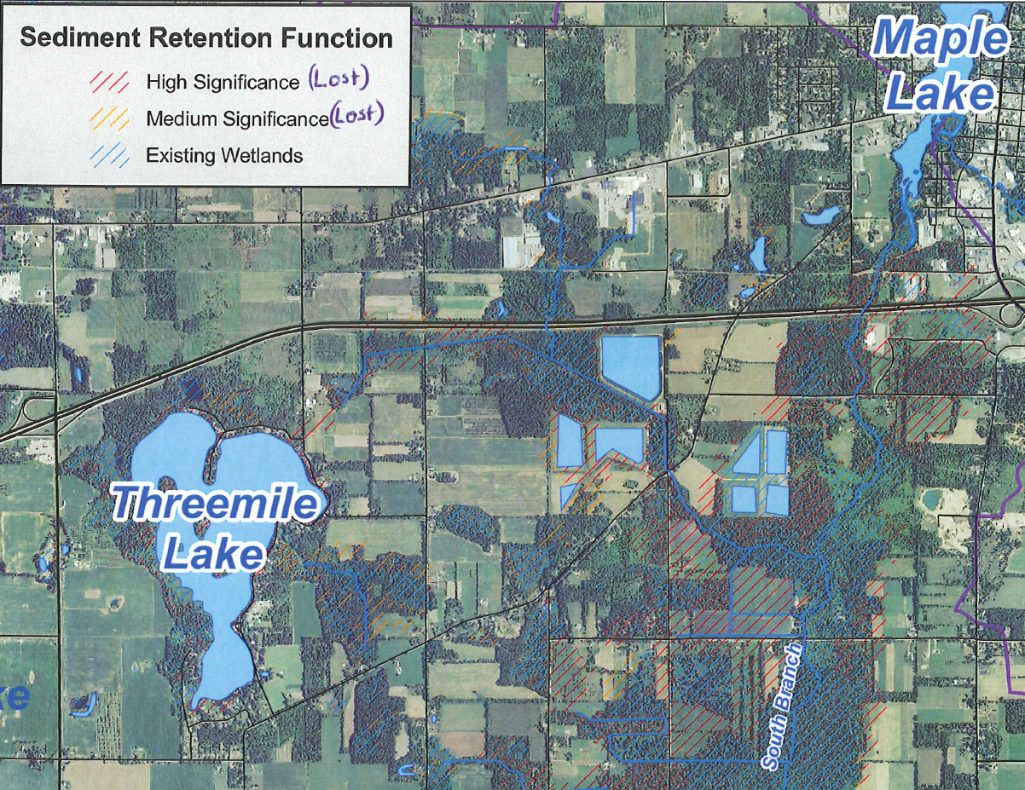
Municipalities – Paw Paw Village
Improve Maple Lake by protecting and restoring wetlands upstream
  Sediment Retention
  Nutrient
  Transformation
  Payment for
  Ecosystem Services
  or Environmental
  Benefit

Slide 21
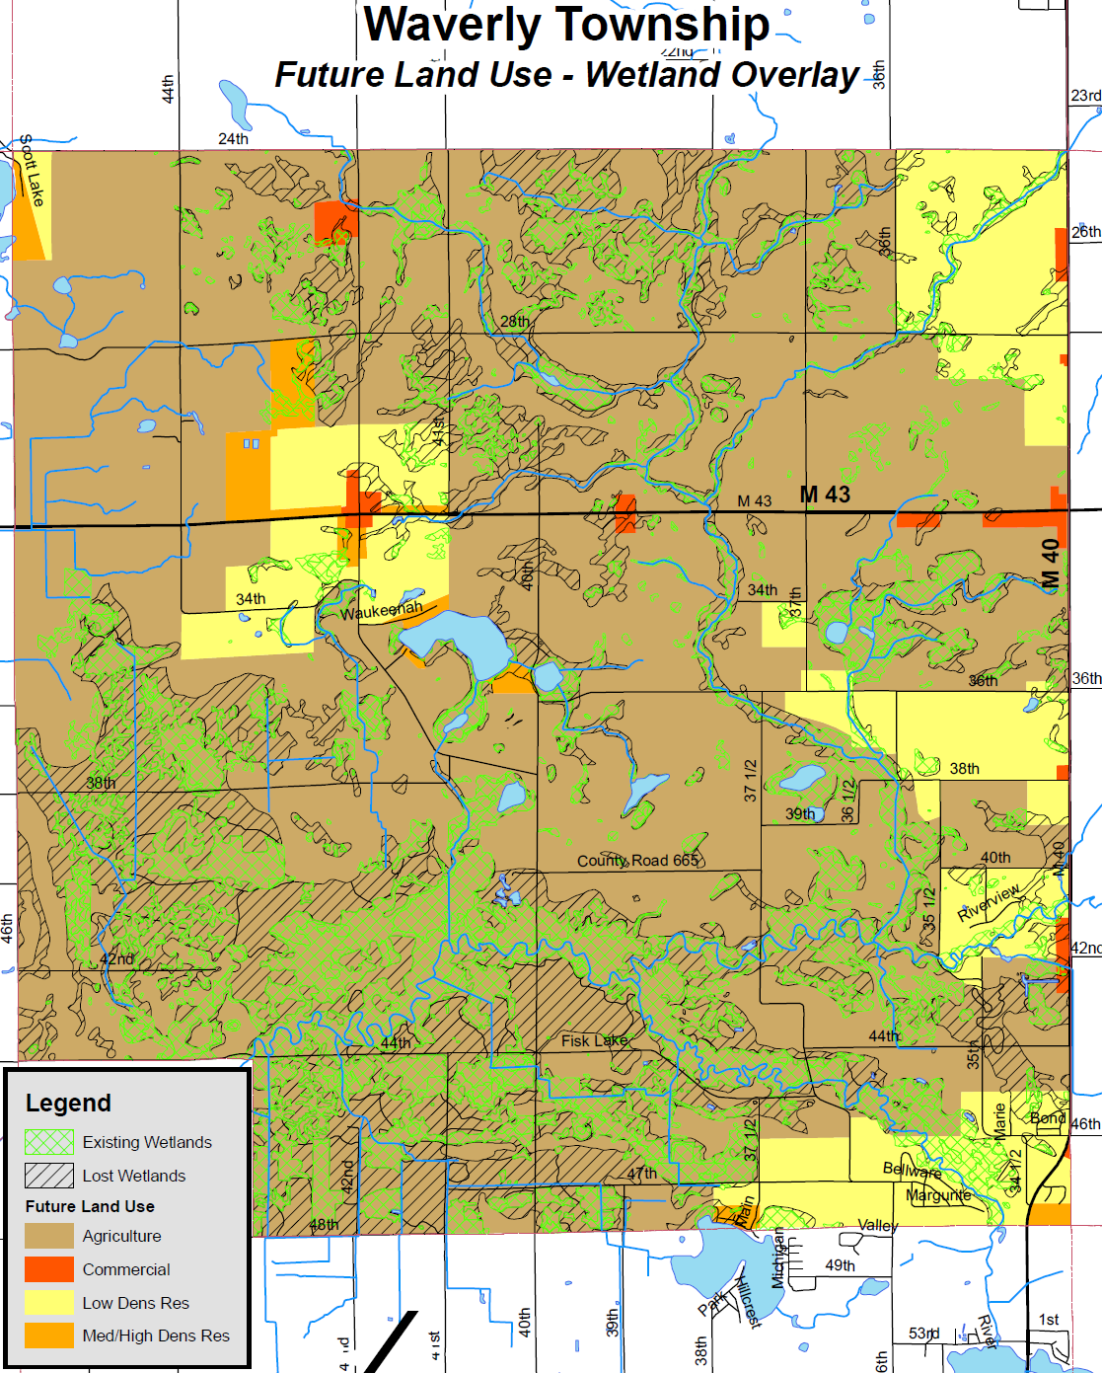
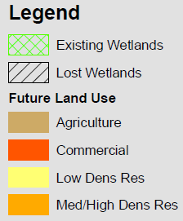
Municipalities – Planning
Planning for Wetlands
Keeping Opportunities for Protection and Restoration

Slide 22
Conservation Groups and Government Agencies
Target Outreach and Score/Rank Projects
  USDA - Wetland Reserve Program (WRP)
  USFWS - Partners for Fish and Wildlife Program
  MDNR – Landowner Incentive Program
  Land Trusts
  Ducks Unlimited

Slide 23
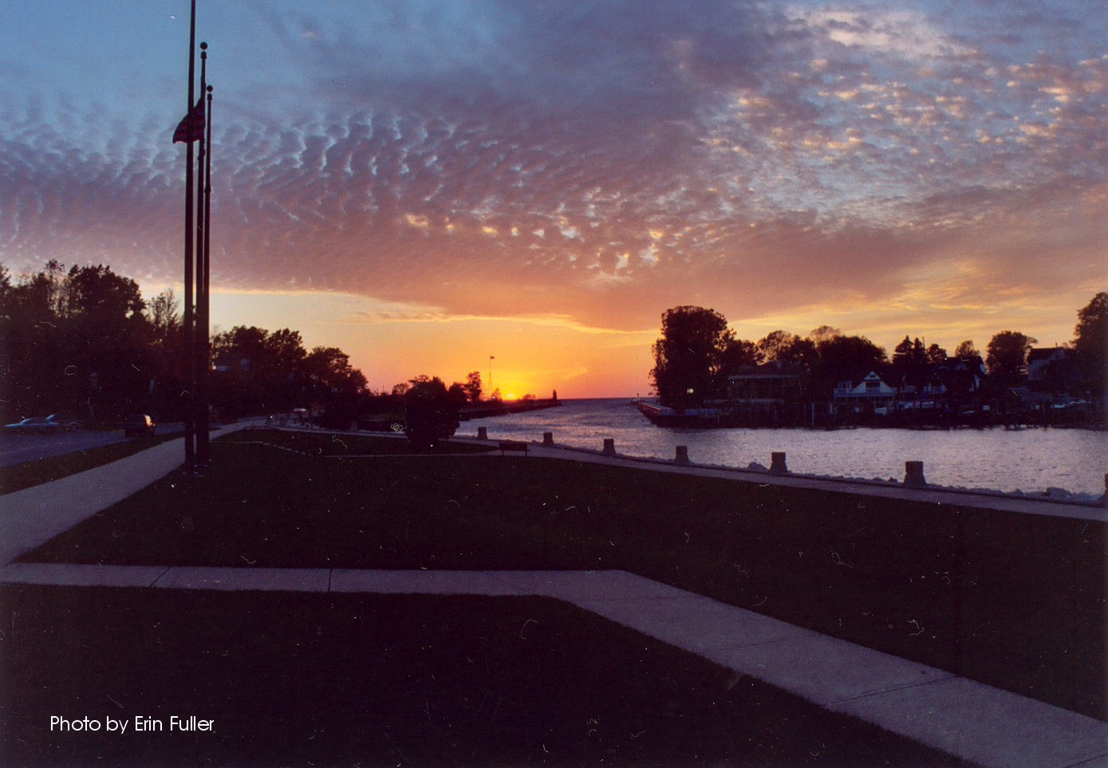
Protect and Restore Wetlands
They Are Working For YOU!

Slide 24
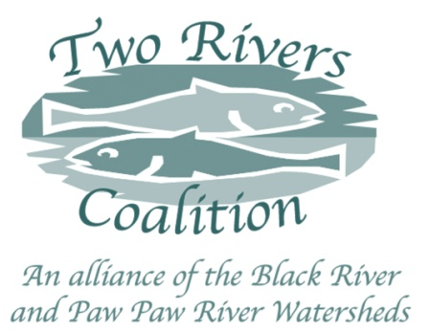
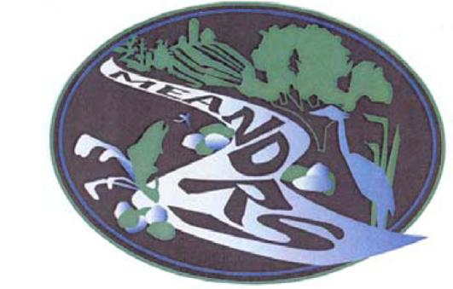
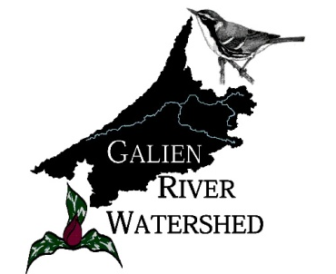
Watershed Organizations
Alliance for the Great Lakes - www.greatlakes.org
  Friends of the St. Joe River - www.fotsjr.org
    Two Rivers Coalition –
    www.TwoRiversCoalition.org
    Hickory Creek Watershed Partnership– www.swmpc.org/hickory.asp
    Friends of McCoy Creek
    Partnership for MEANDRS
  Galien River Watershed Project –
  www.swmpc.org/grw.asp
  Several Lake Associations (Paw Paw Lake)

Slide 25
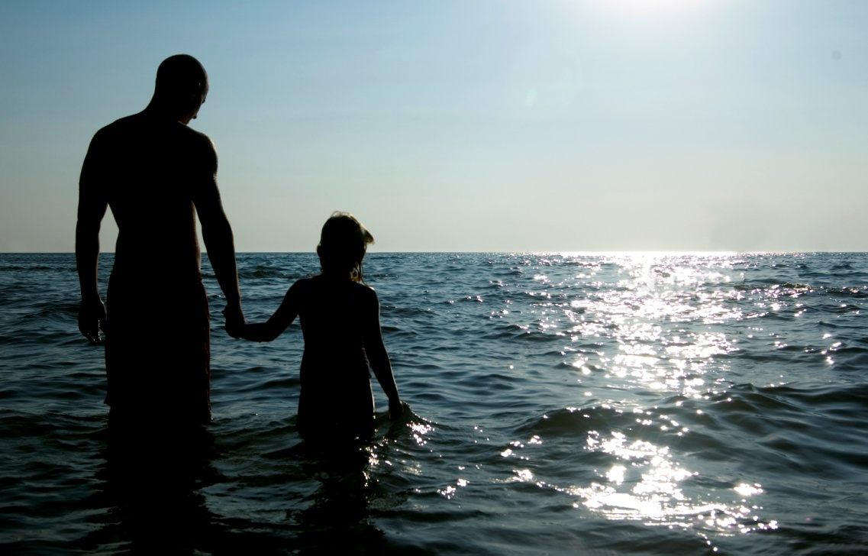
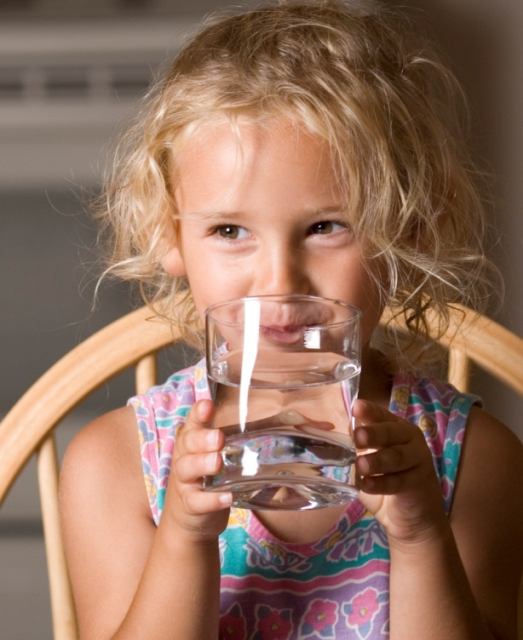
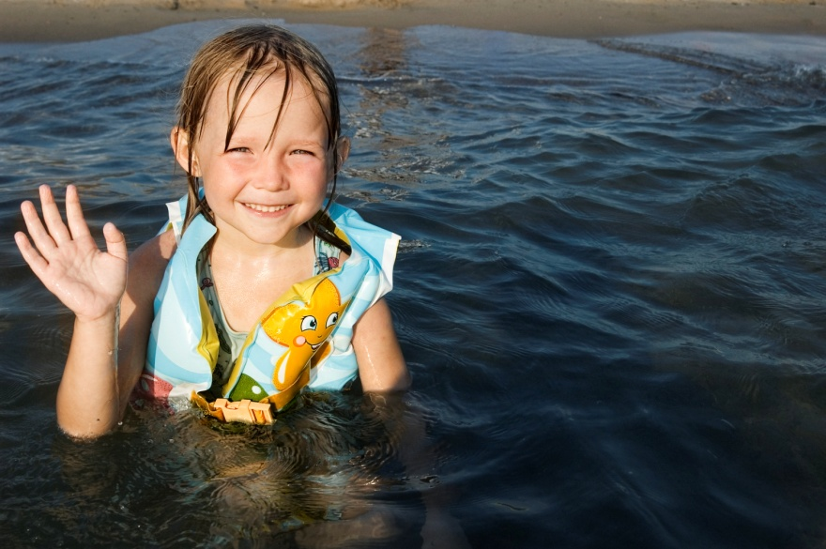
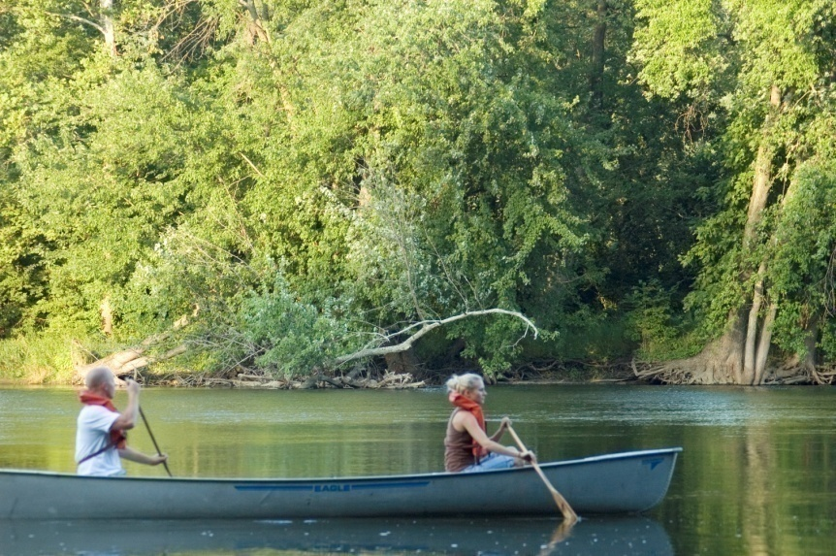

Do your part so we can enjoy….
Swimming
Drinking water
Playing in the water
Canoeing
For more information visit:
www.swmpc.org/water.asp

