Slide 1
Aluminum Recycling Hydro Aluminum Cassopolis, Michigan

Slide 2
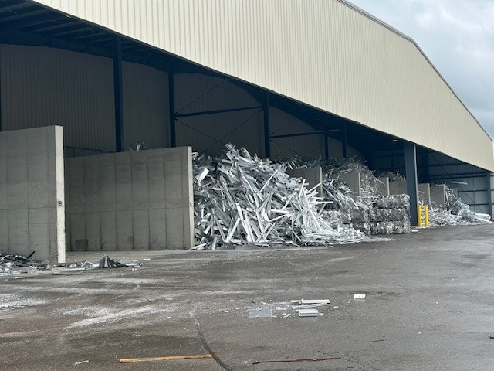
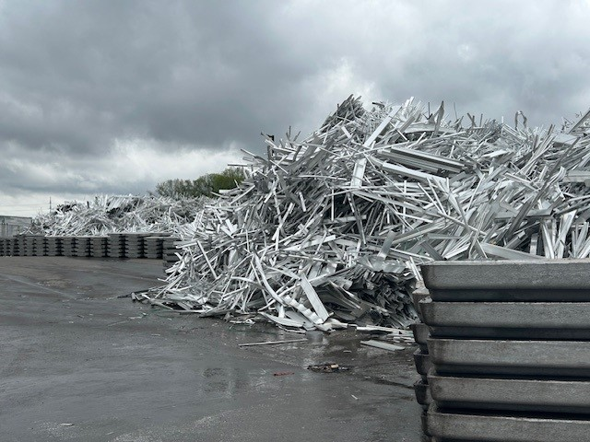
Hydro Aluminum Cassopolis
Notes:
We receive truck loads of scrap aluminum from various vendors around the Midwest.

Slide 3
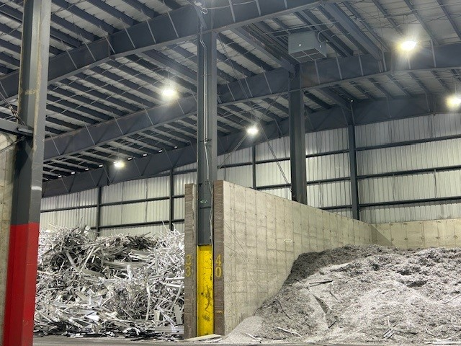
Hydro Aluminum Cassopolis
Notes:
Aluminum is brought from the outside scrap yard to the inside scrap yard. Scrap must be dry to be added to the furnace.

Slide 4
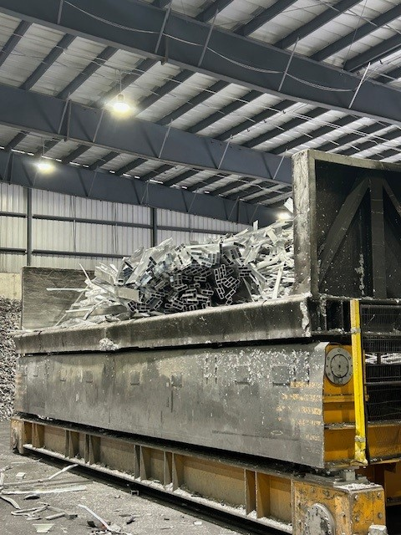
Hydro Aluminum Cassopolis
Notes:
Scrap is loaded into the charge car with a payloader. Each time the charge car is loaded there will be between 10 thousand to 20 thousand pounds of material in the charge car.

Slide 5
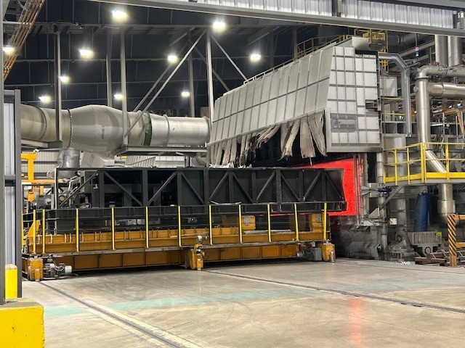
Hydro Aluminum Cassopolis
Notes:
The charge car is moved directly in front of the furnace in preparation for melting. Melting, mixing, and sampling will occur until we have achieved the customers specifications. This process take about 2-3 hours. There may be 100 thousand pounds of metal in a charge.

Slide 6
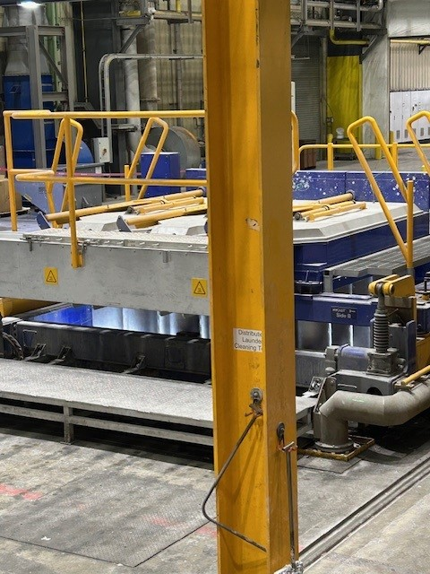
Hydro Aluminum Cassopolis
Notes:
Molten aluminum is moved through a launder system to the casting table. The function of the casting table is to form liquid metal into logs or billets.

Slide 7
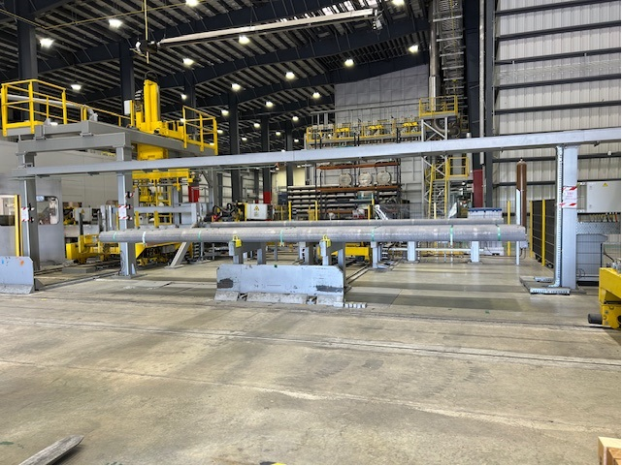
Hydro Aluminum Cassopolis
Notes:
The billets are sent to a saw to be cut and bundled.

Slide 8
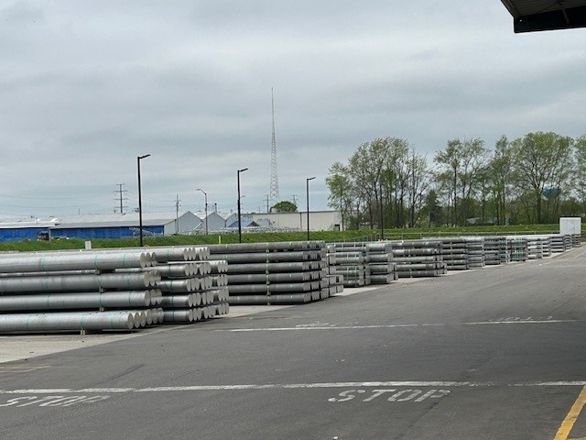
Hydro Aluminum Cassopolis
Notes:
After we have completed our final quality checks the billets are ready to be loaded and shipped to customers.

Slide 9
Hydro Aluminum Cassopolis
Approximately 25% of the material we process is ‘post consumer scrap’. This aluminum had a useful purpose and now at it’s end of life. We purchase this scrap and divert it from a landfill to be used again.
Another large percentage of our material is aluminum that becomes scrap in our clients manufacturing processes. They purchase our aluminum, and in the manufacturing of their product a certain percent becomes scrap, that scrap comes back to us and we recycle it.
Scrap dealers purchase aluminum from industrial accounts and in turn sell the aluminum to Hydro.
We acquire approximately 18 to 19 million pounds of aluminum a month and we produce approximately 14 to 15 million pounds per month.
Our sister facility's in Kentucky and Texas produce relatively similar quantities following a very similar process as Hydro Cassopolis.

Slide 10
Hydro Aluminum Cassopolis
Questions?

