Slide 1
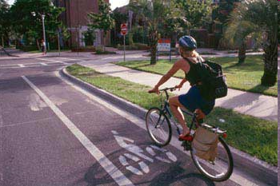
SW MI Non-Motorized Plan
Focus: Berrien County
Connecting Communities One Trail At A Time
WELCOME
Sign in
Fill out a name tag

Slide 2
Berrien County Non-Motorized Summit
.
Welcome – Marcy Hamilton, SWMPC and Andrew von Mauer, Andrews University
Sate Long Range Plan – Brad Sharlow and Kyle Haller, MDOT
MDOT Non-Motorized Initiative – Brian Sanada, MDOT
Major Trail Initiatives - Marcy Hamilton, SWMPC
-Berrien County Linear Park Plan – Brian Bailey, Berrien County Parks
-IN-MI River Valley Trail Expansion - Heather Cole, Be Healthy Berrien
-Creating A Vision for Berrien County – JB Hoyt, Strategic Leadership Council
Break Out Session/Report Out
Next Steps– Marcy Hamilton & JB Hoyt

