Slide 1
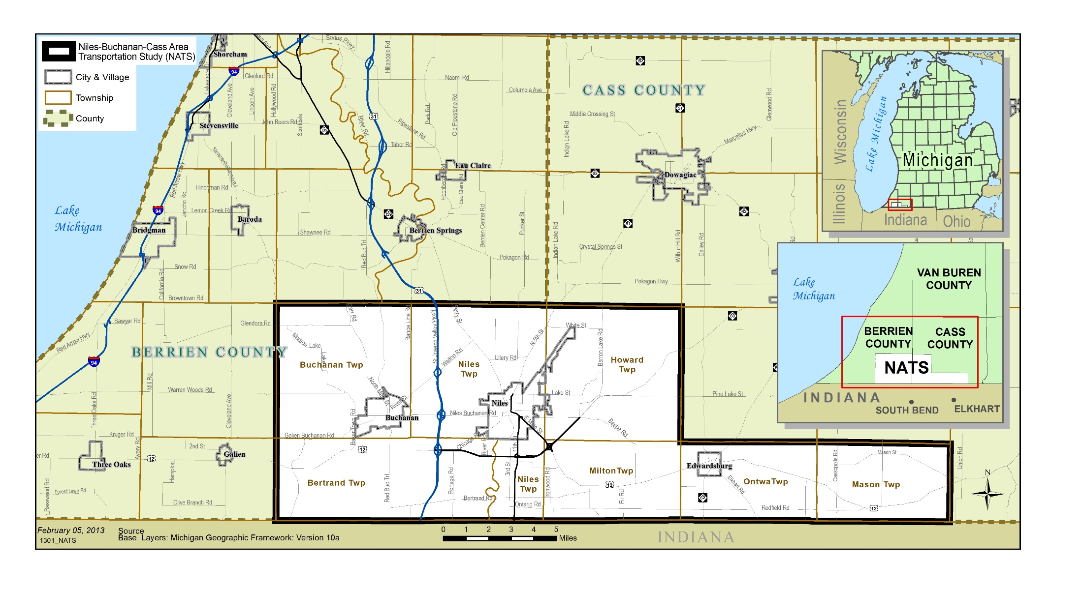
NATS Safety
35,092 people died in vehicle crashes in 2015
Up 7.2 percent from 32,744 in 2014.
Largest percentage increase in nearly 50 years.
Source: National Highway Traffic Safety Administration (NHTSA)

Slide 2
Performance Measures:
FHWA Safety Performance Measure final rule established five performance measures utilizing five year moving averages:
Numbers of Fatalities
Rate of Fatalities per 100 million Vehicle Miles Traveled (VMT)
Number of Serious Injuries
Rate of Serious Injuries
Number of Non-Motorized Fatalities and Non-Motorized Serious Injuries.

Slide 3
Safety Planning Overview
Where Are we?
What are the current values for the Safety Performance Measures
Where are we headed?
What do the trends in safety tell us about past progress.
Where do we need to go
The Performance targets:
How do we get there?
Strategies to improve the performance measures
The Safety Technical Report explains the first Two items

Slide 4
What’s in the Report
Total Crashes within NATS between 2006-2015
Number of Fatalities and Serious Injuries
10 years of safety trends
Non-Motorized Crashes, Fatalities, and Serious Injuries
Location of Crashes

Slide 5
Data Sources
UD-10 Report
A uniform Report every law enforcement agency uses to record details of a crash
Compiled by MDOT and distributed to Roadsoft and MichigancrashFacts.org

Slide 6
35,092 people died in vehicle crashes in 2015
Up 7.2 percent from 32,744 in 2014.
Largest percentage increase in nearly 50 years.
Source: National Highway Traffic Safety Administration (NHTSA)
Notes:
Although the U.S. population has been growing steadily since 1975, the rate of crash deaths per 100,000 population in 2015 is about half of what it was 40 years ago. However, the overall per capita death rate and the per capita death rate for passenger vehicle occupants in 2015 increased 6 percent from the rates in 2014.

Slide 7
Annual Crashes, Fatalities, and Serious Injuries
Compared to the number of total crashes fatalities and serious injuries are rare
Lowest year for crashes was 2011, Highest Year was 2008
Lowest years for fatalities were 2008, 2009, 2010 & 2014. Highest Years were 2011 & 2012
Lowest year for Serious Injuries was 2013. Highest was 2007
Year | Total Crashes | Fatalities | Serious Injuries
2006 | 1,611 | 8 | 56
2007 | 1,777 | 9 | 59
2008 | 1,816 | 6 | 66
2009 | 1,555 | 6 | 34
2010 | 1,479 | 6 | 38
2011 | 1,313 | 14 | 34
2012 | 1,329 | 14 | 30
2013 | 1,379 | 9 | 21
2014 | 1,538 | 6 | 32
2015 | 1,465 | 10 | 26
Total | 15,262 | 88 | 396

Slide 8
PERFORMANCE MEASURE: Number of Fatalities And the Number of Serious Injuries: 5-yr Moving Average
Year | Total Crashes | Fatalities | Serious Injures
2011 | 1588 | 8.2 | 46.2
2012 | 1498 | 9.2 | 40.4
2013 | 1411 | 9.8 | 31.4
2014 | 1408 | 9.8 | 31.0
2015 | 1405 | 10.6 | 28.6
Fatalities and Serious Injuries are what will be reported for the Safety Performance Measures

Slide 9
Trends in Total Crashes For the NATS Planning Area: 2006-2015
High Variability per year with a possible downward trend

Slide 10
Trends in Fatalities and Serious Injuries
Serious Injuries have been declining. Fatalities have slightly increased but its not a significant increase.

Slide 11
Comparison to Statewide Trends - Fatalities
GRAPHICAL REPRESENTATION OF TRENDS. NOT TO SCALE
Apparently No Relationship Between Statewide Fatalities and Fatalities within NATS

Slide 12
Comparison to Statewide Trends- Serious Injuries
GRAPHICAL REPRESENTATION OF TRENDS. NOT TO SCALE
More Variation in NATS but Both the State and NATS Show a Decrease in Serious Injuries

Slide 13
Pedestrian and Bicycle Crashes
Year | Total Crashes | Pedestrian | Bicyclist | Total Non-Motorized Crashes
2006 | 1,611 | 14 | 12 | 26
2007 | 1,777 | 14 | 11 | 25
2008 | 1,816 | 13 | 8 | 21
2009 | 1,555 | 8 | 14 | 22
2010 | 1,479 | 10 | 9 | 19
2011 | 1,313 | 10 | 6 | 16
2012 | 1,329 | 9 | 9 | 18
2013 | 1,379 | 10 | 9 | 19
2014 | 1,538 | 11 | 9 | 20
2015 | 1,465 | 14 | 7 | 21
Total | 15,262 | 113 | 94 | 207

Slide 14
Pedestrian & Bike Fatalities & Serious Injuries
Pedestrians & Bikes
207 Crashes
7 Fatalities
26 Serious Injuries
Pedestrians & Bikes
1.4% of All Crashes
8.0% of All Fatalities
6.8% of All Serious Injuries
 | Pedestrian |  | Bicyclist
Year | Fatalities | Serious Injuries | Fatalities | Serious Injuries
2006 |  | 2 | 2 | 1
2007 | 1 | 4 |  | 2
2008 | 1 | 7
2009 |  | 1 |  | 1
2010 |  | 2
2011
2012 | 2 |  |  | 2
2013
2014 |  | 3
2015 | 1 | 2
Total | 5 | 21 | 2 | 6

Slide 15
PERFORMANCE MEASURE: Number of Non-Motorized Fatalities and Non-Motorized Serious Injuries: 5-yr Moving Average
 | Pedestrian |  | Bicyclist |  | Non-Motorized Total
Year | Fatalities | Serious Injuries | Fatalities | Serious Injuries | Fatalities & Serious Injuries
2011 | 0.4 | 2.8 | 0 | 0.6 | 3.8
2012 | 0.5 | 0.75 | 0 | 0.75 | 3.2
2013 | 0.4 | 0.6 | 0 | 0.6 | 1.6
2014 | 0.5 | 0.5 | 0 | 0.5 | 1.8
2015 | 0.6 | 1 | 0 | 0.4 | 2

Slide 16
Comparison to Statewide Trends Non-Motorized Fatalities & Serious Injuries
GRAPHICAL REPRESENTATION OF TRENDS. NOT TO SCALE
Both NATS and the Michigan as a whole had a decrease in No-Motorized Fatalities & Serious Injuries. But the relationship is not significant.

Slide 17
Where Are the Crashes Occurring?

Slide 18
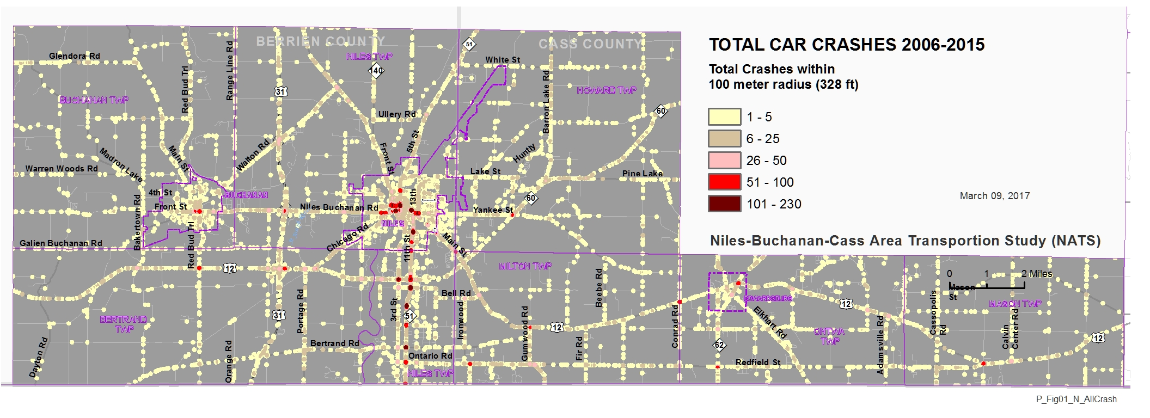
Crash Density
All Crashes 2006-2015
Within a 100 Meter (328 ft) Radius of Each Other
Total Crashes:
15,262`
Notes:
Work on this tomarow

Slide 19
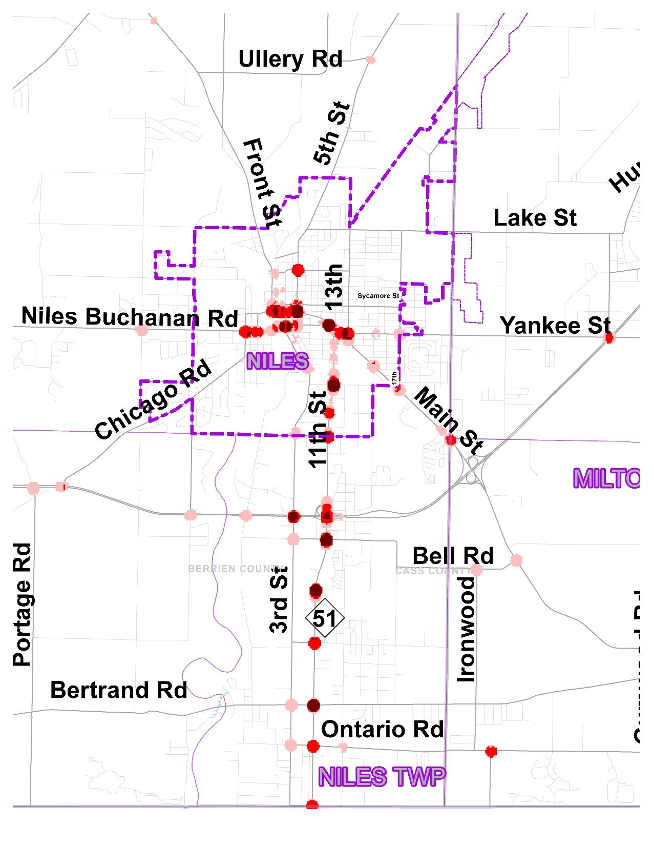

Slide 20
Highest Crash Road Segments
Road | From | To | Jurisdiction | Crashes
S 11th St | Wrightman St | Chestnut | Niles Twp | 154
S 11th St | Moore Dr | Bell Rd | Niles Twp | 154
US 12 | Bell Rd | Gumwood Rd | Milton Twp | 152
S 11th St | Lambert St | Silverbrook St | Niles | 118
S 11th St | Ontario Rd | E Bertrand Rd & W Bertrand Rd | Niles Twp | 107
S 11th St | Silverbrook St | Superior St | Niles | 104
Broadway St | S 9th St | E Main St & N 10th St & S 10th St | Niles | 95
S 11th St | Fort St | Marion St | Niles | 86
S 11th St | E Bertrand Rd & W Bertrand Rd | De Witt Ave | Niles Twp | 80
E Pulaski Hwy | High Bridge Rd | Bakertown Rd | Bertrand Twp | 80

Slide 21
Highest Crash Intersections
Intersection | Jurisdiction | Number of Crashes 2006-2015
Silverbrook St & S 11th St | City of Niles | 236
Bell Rd & S 11th St | Niles Twp | 227
Chestnut & S 11th St | Niles Twp | 191
E Main St & Broadway St & N 10th St & S 10th St | City of Niles | 174
N 5th St & E Main St | City of Niles | 155
S 11th St & Lawndale St | Niles Twp | 150
N 3rd St & Broadway St & S 3rd St | City of Niles | 138
S 11th St & E Bertrand Rd & W Bertrand Rd | Niles Twp | 135
N 2nd St & S 2nd St & E Main St | City of Niles | 128
S 13th St & Oak St & E Main St | City of Niles | 125

Slide 22
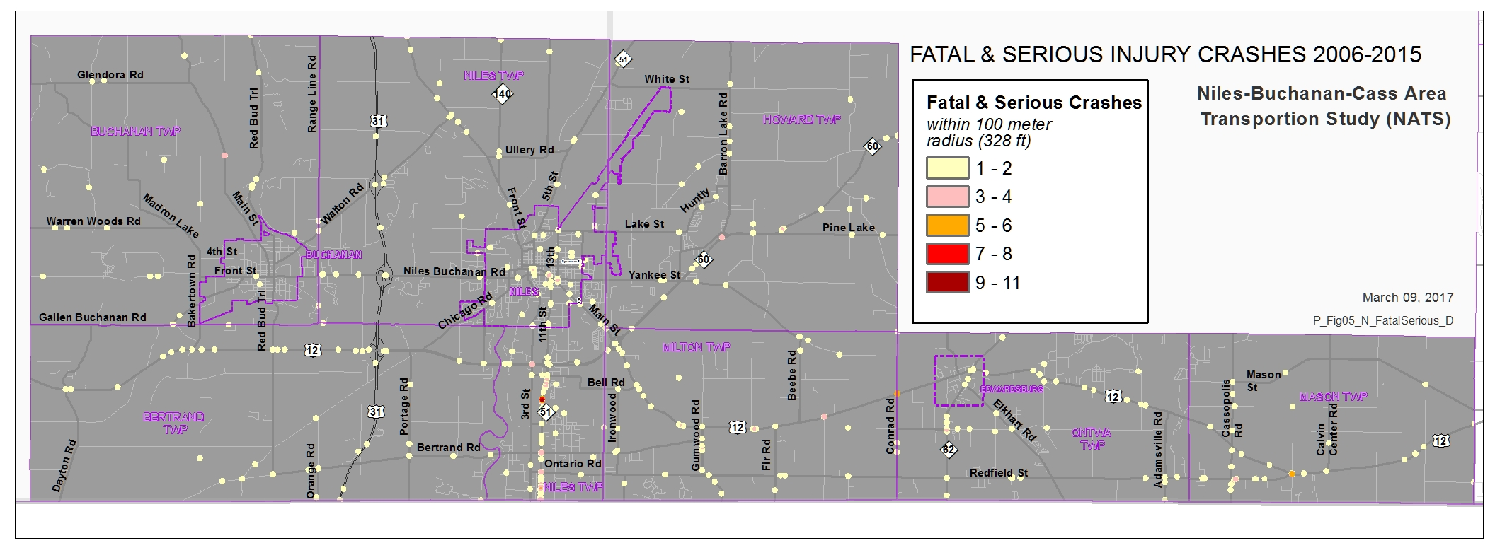
Fatal & Serious Injury
Crash Density
2006-2015
Within a 100 Meter (328 ft) Radius of Each Other

Slide 23
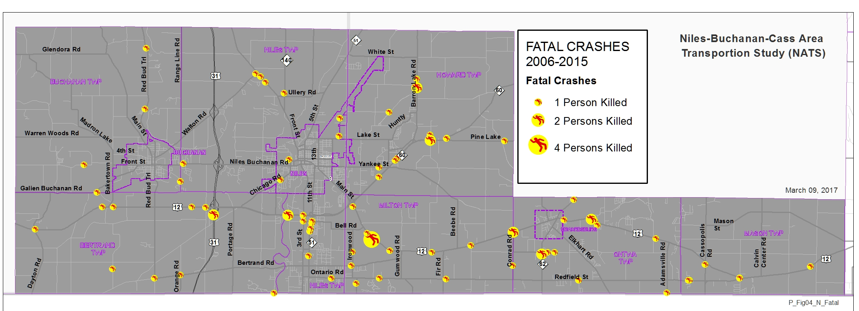
Location of Fatal Crashes
2006-2015

Slide 24
Highest K&A Road Segments
Road | From | To | Jurisdiction | K&A
S 11th St | Stateline Rd | Gary Ct | Niles Twp | 10
US 12 | Bell Rd | Gumwood Rd | Milton Twp | 9
S 11th St | Wrightman St | Chestnut | Niles Twp | 9
S 11th St | Moore Dr | Bell Rd | Niles Twp | 6
US 12 | Leet Rd | Fir Rd | Milton Twp | 5
Gumwood Rd | Redfield St | Bertrand St | Milton Twp | 5
M 60 | Lilac Ave | Barron Lake Rd | Howard Twp | 4
E Pulaski Hwy (US-12) | High Bridge Rd | Bakertown Rd | Bertrand Twp | 4
S 11th St | Chestnut | Moore Dr | Niles Twp | 4
E Pulaski Hwy (US-12) | Red Bud Trl | W Pulaski Hwy | Bertrand Twp | 4

Slide 25
Highest K&A Intersections
Intersection | Jurisdiction | Number of Crashes 2006-2015
Chestnut & S 11th St | Niles Twp | 11
US 12 & Conrad Rd | Milton Twp | 6
Old M 205 & US 12 | Mason Twp | 5
US 12 & Five Points Rd | Mason Twp | 4
S 11th St & E Bertrand Rd & W Bertrand Rd | Niles Twp | 4
S 11th St & Stateline Rd | Niles Twp | 4
Redfield St & Old M 205 | Mason Twp | 4
S 3rd St & E Pulaski Hwy | Niles Twp | 3
Moore Dr & S 11th St | Niles Twp | 3
M 62 & May St | Ontwa Twp | 3

Slide 26
Fatalities and Serious Injuries by Road Type
MDOT = 46%
Locally Controlled = 54%
MDOT =47%
Locally Controlled = 53%

Slide 28
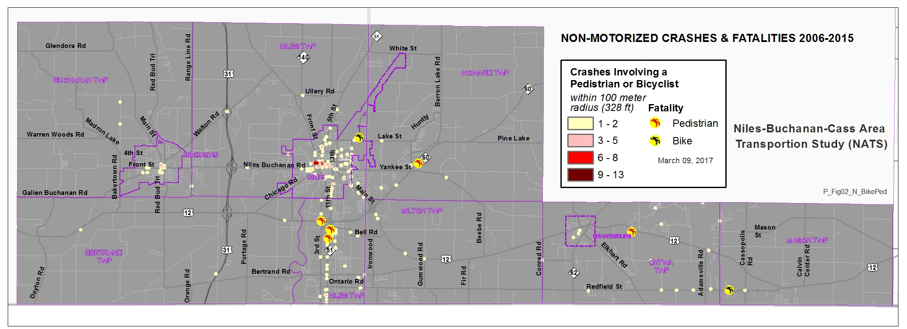
Pedestrian & Bicycle
Crash Density
2006-2015
Within a 100 Meter Radius of Each Other

Slide 29
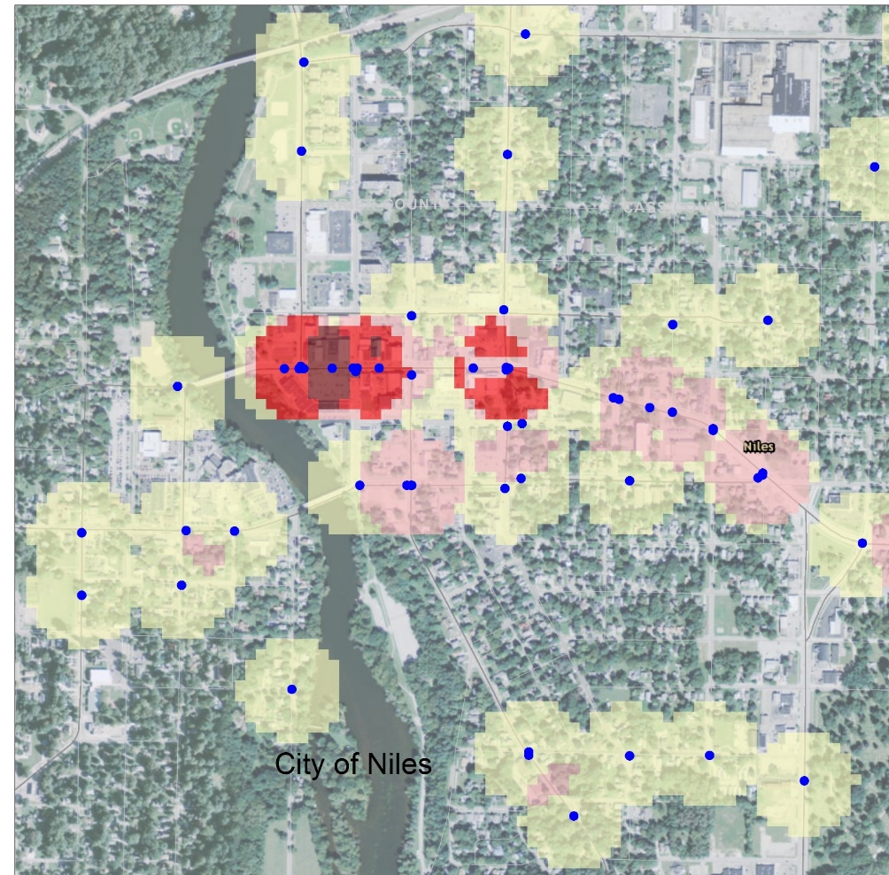
Pedestrian and Bike Highest Crash Roads
map
Road Name | Jurisdiction | Non-motorized Crashes | Fatalities & Serious Injuries
Main | City of Niles | 21 | 2
11th | Niles Twp | 13 | 8
5th | City of Niles | 12 | 2
Broadway | City of Niles | 8 | 1
17th | City of Niles | 6 | 0
3rd | City of Niles | 5 | 2
Main | Niles Twp | 5 | 0
Front | Buchanan | 4 | 0
Main | Buchanan | 4 | 0
13th | Niles Twp | 4 | 2

Slide 30
Pedestrian & Bicycle Involved Crashes by Jurisdiction

Slide 31
Pedestrian & Bicycle Fatalities & Serious Injuries by Jurisdiction

Slide 32
Calculating Crash Rates:
 | Yearly VMT | Fatalities | Serious Injuries
2011 | 216,454,344 | 5 | 14
2012 | 222,485,495 | 7 | 16
2013 | 288,258,604 | 6 | 12
2014 | 302,920,472 | 4 | 21
2015 | 309,832,696 | 6 | 23
The Rate Allows Safety Comparisons Between Different Areas
Vehicle Miles Traveled (VMT) was only Attainable for the Urbanized Area, Not all of NATS.
Only 5 years of VMT was available

Slide 33
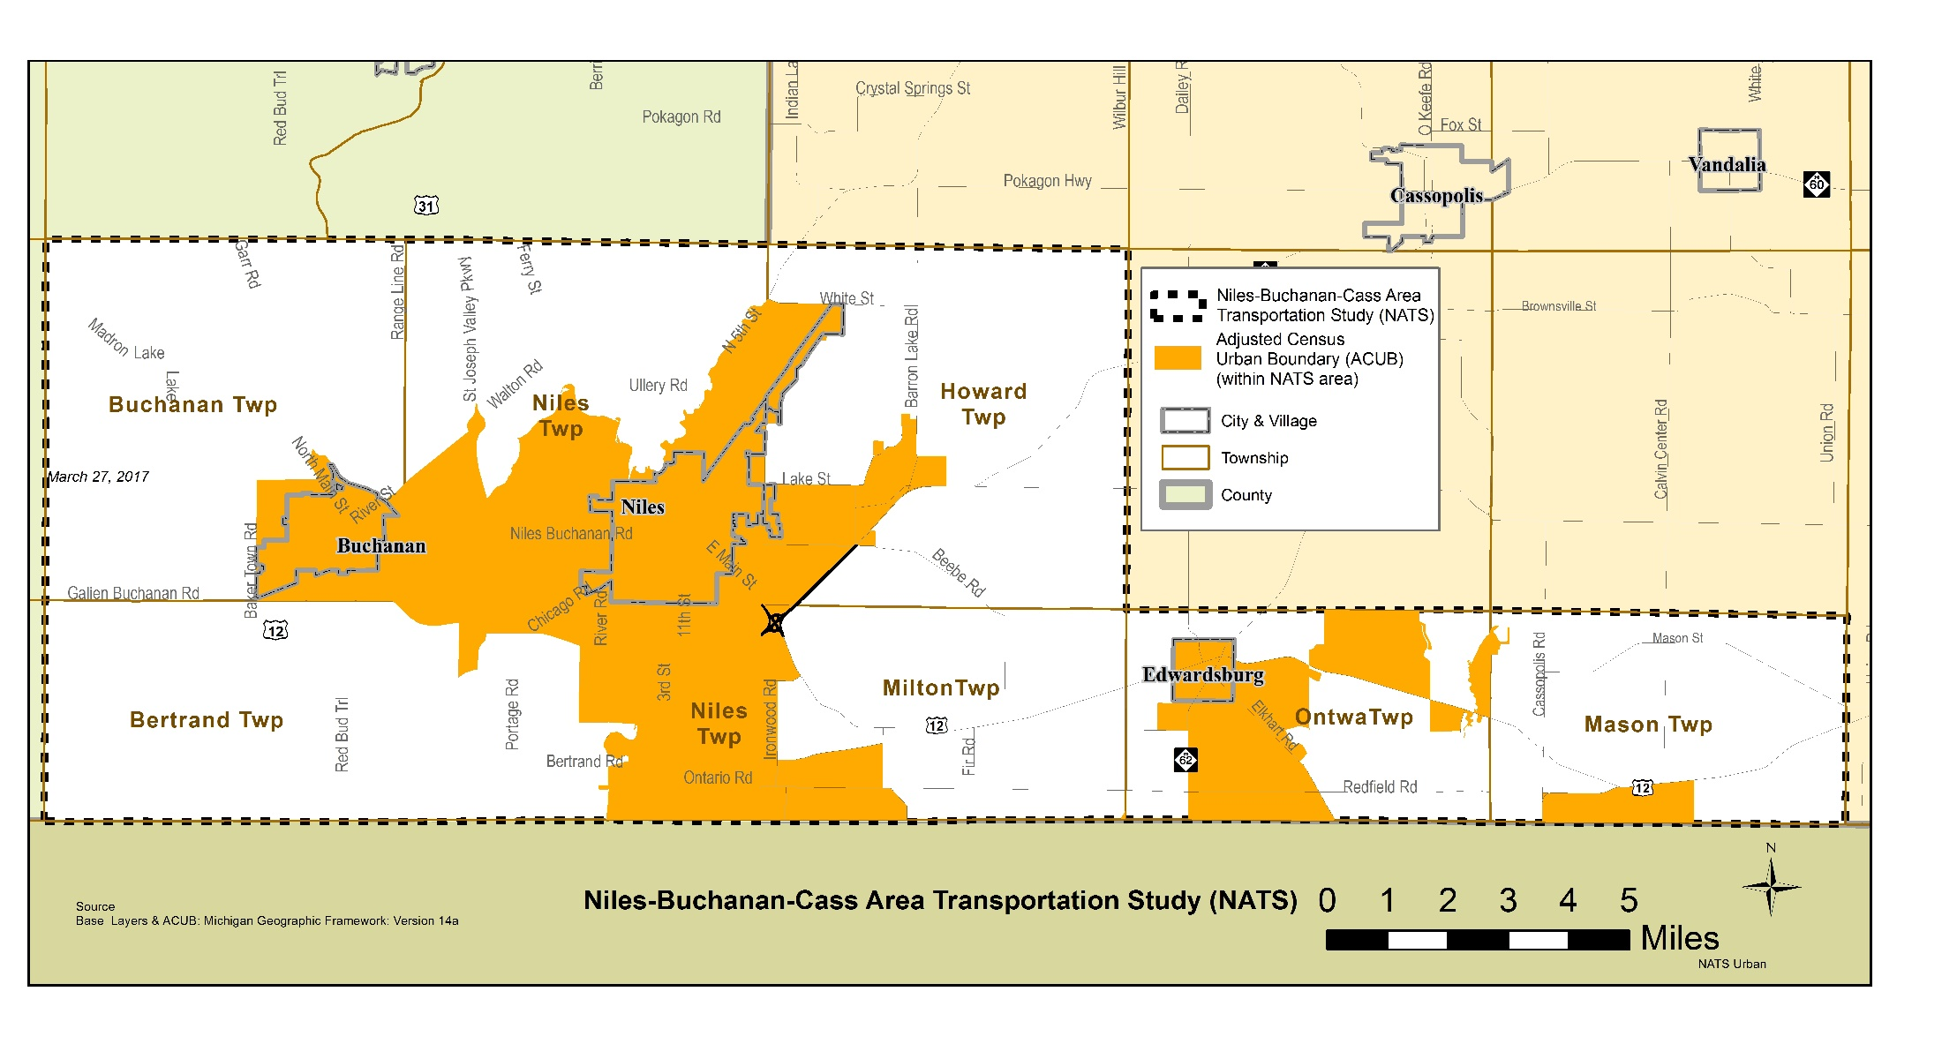

Slide 34
Crash Rates
 | Fatality Rate | Serious Injury Rate
2011 | 2.31 | 6.47
2012 | 3.15 | 7.19
2013 | 2.08 | 4.16
2014 | 1.32 | 6.93
2015 | 1.94 | 7.42
2015 5-yr average | 2.16 | 6.44
Changes in VMT alone can’t explain changes in fatalities or serious injuries
Only have 5 years so we can’t see trends using the moving average
NATS* has a higher fatality rate than Michigan or The U.S.
*Based on the Urbanized Area
Comparison between NATS, State, and National Fatality Rates 5-yr average 2011-2015
NATS | State | U.S.
2.16 | 0.96 | 1.11

